Slide 1

Stock Market Analysis Project
Using NLP and Machine Learning for Enhanced Forecasting:-
This project combines financial data and Twitter sentiment analysis to
predict stock market trends. By leveraging Natural Language Processing
(NLP) and machine learning techniques, it identifies correlations between
tweet sentiment and stock price movements.
by Shovan Bera

Slide 2

Project Overview
This project predicts stock market movements. We combine Twitter dataset with stock price data. We analyze tweets sentiment score using NLP techniques. Sentiment is categorized as positive, negative, or neutral. Then we correlate sentiment with price changes. This helps identify trends for stock price predictions.
Stock Data
Twitter Data
Daily closing and adjusted prices of stocks.
Thousands of stock-related tweets.

Slide 3

Problem Statement &
Objectives
Problem Statement
Raw tweets are unstructured and noisy.
Hard to extract meaningful sentiment trends.
Objectives
Clean and structure tweet data efficiently.
Extract accurate sentiments using NLP.
Correlate sentiment with stock prices.

Slide 4
Dataset Description
Stocks Dataset
Tweets Dataset
5 columns: Positive, Negative, Neutral.
4 columns: Date, closing_price.
Includes adj_price, close_price.
Includes adj_close_price, Tweets.
Contains 600 rows of data.
Contains 3653 rows of data.

Slide 5

Methodology
Data Collection
Gathered sentiment values and pricing data.
Included raw tweet text with stock prices.
1
2
Data Preprocessing
Handled irregular tweet formatting and line breaks.
Structured each tweet into a single, consistent row.

Slide 6

Exploratory Data Analysis (EDA)
1
Stocks Data Analysis
2
Tweets Data Analysis
Sentiment histograms (Positive, Negative, Neutral).
Closing price over time.
Line plots of adj_price vs close_price.
Line plots of adj_price vs close_price.
Tweet length distribution
Correlation heatmaps.
Correlation heatmaps.
3
Merged Data Analysis
Combined insights from both datasets.
Closing price over time, Tweet length distribution, line plots, and correlation
heatmaps.

Slide 7
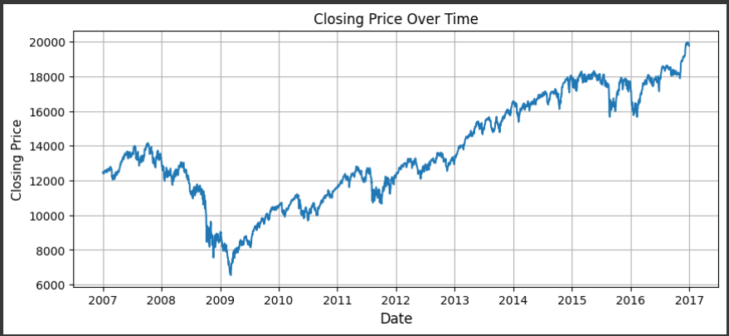
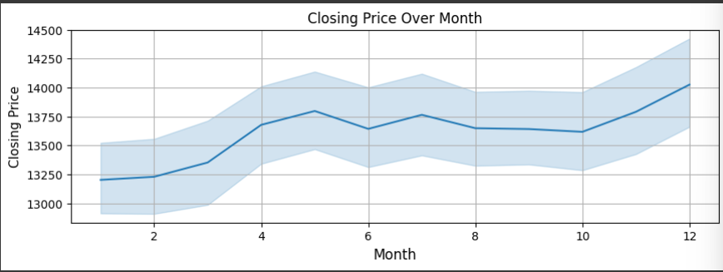
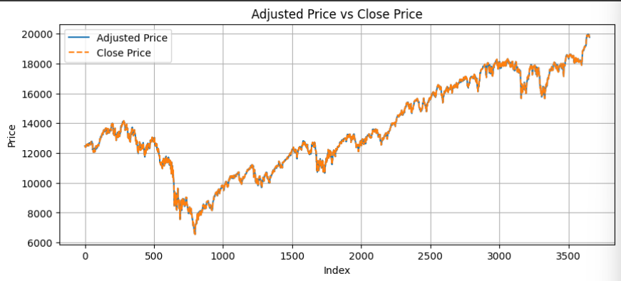
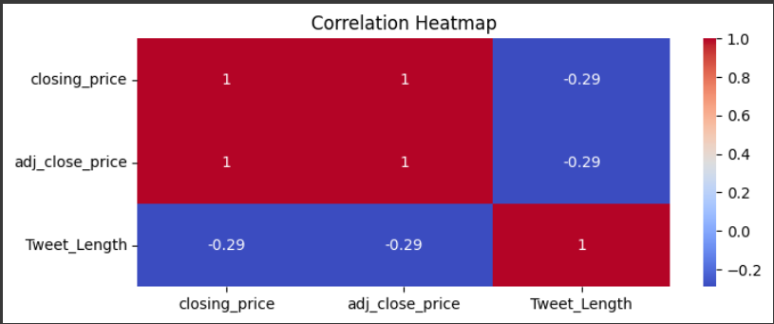
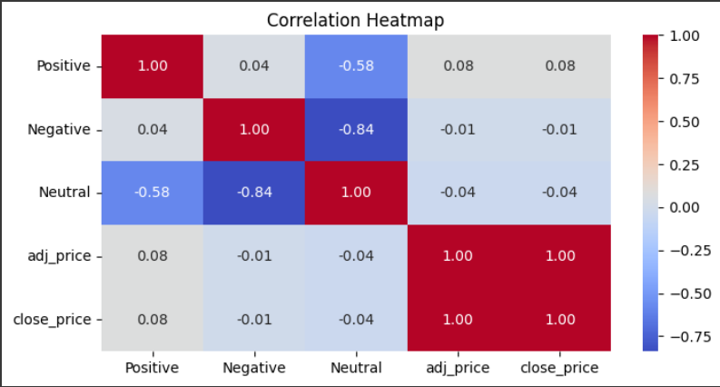
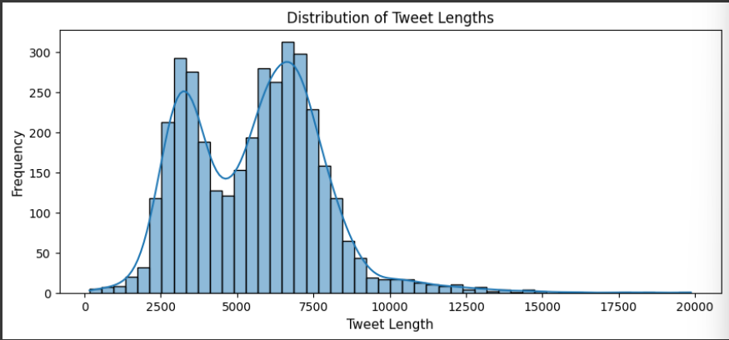
EDA Visualization

Slide 8
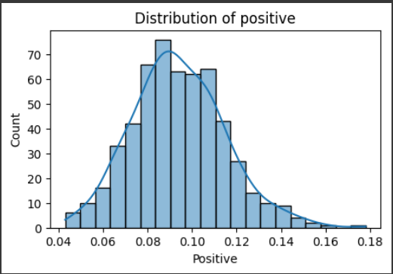
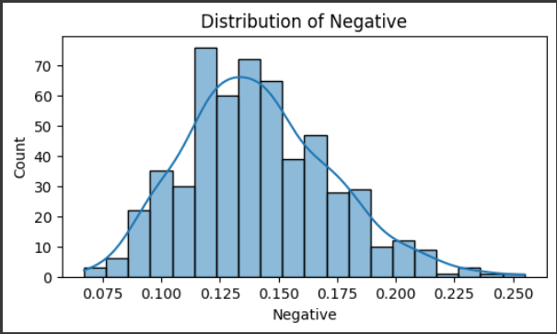
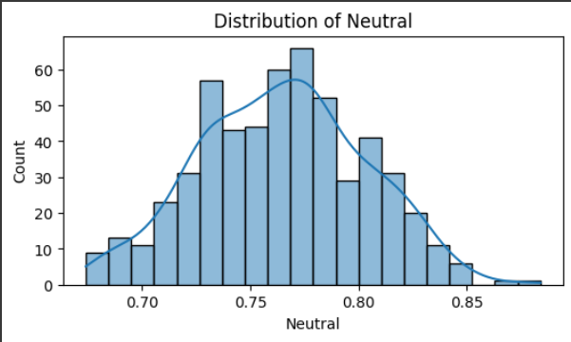
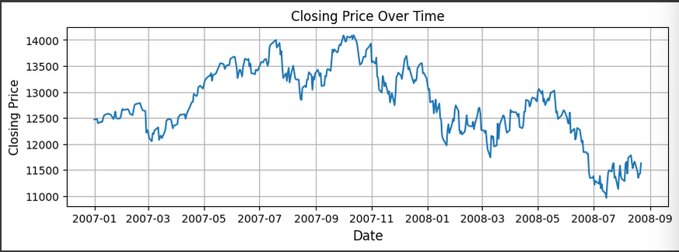
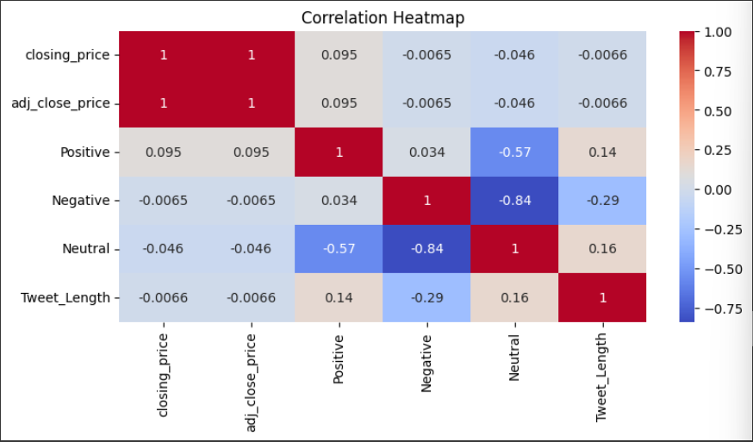
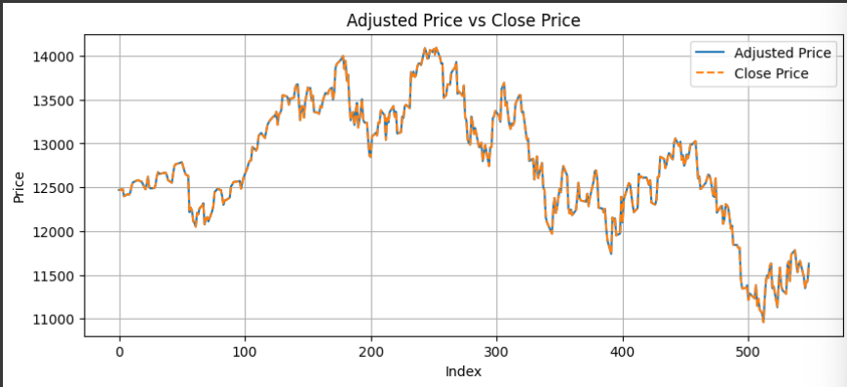

Slide 9




Technology & NLP
Python
Primary programming language.
Libraries
Pandas, NumPy for data analysis.
NLTK, VADER for NLP tasks.
Process
Text cleaning and tokenization.
Stemming, lemmatization, and TF-IDF.
Sentiment analysis using VADER.

Slide 10
Natural Language Processing (NLP)
Text Preprocessing
Removed URLs, mentions, hashtags, and punctuation.
1
Tokenized words; applied stemming and lemmatization.
Converted cleaned tweets into a corpus.
Feature Extraction
2
Used TF-IDF to convert text into numerical features.
Captured term frequency and inverse document frequency.
Sentiment Analysis
3
Applied VADER for sentiment scoring.
Categorized sentiments as positive, neutral, negative.

Slide 11
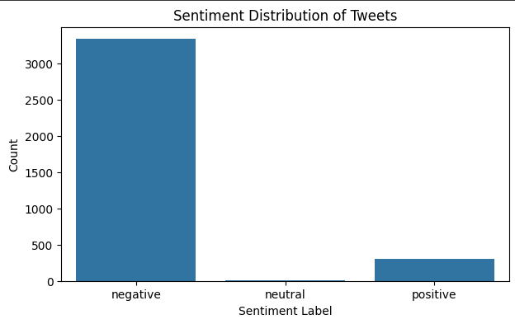
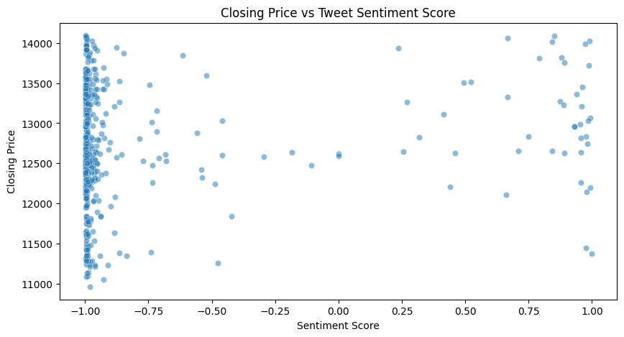
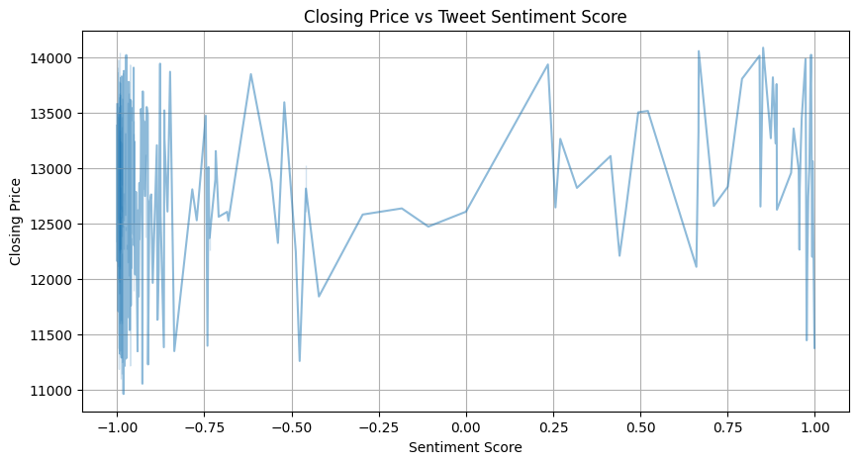
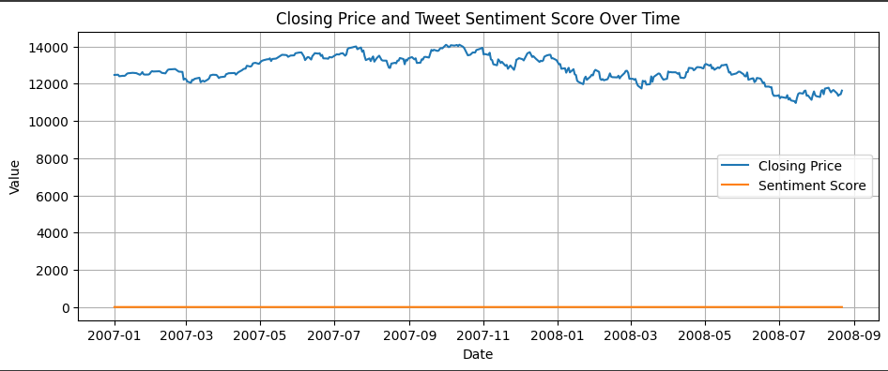
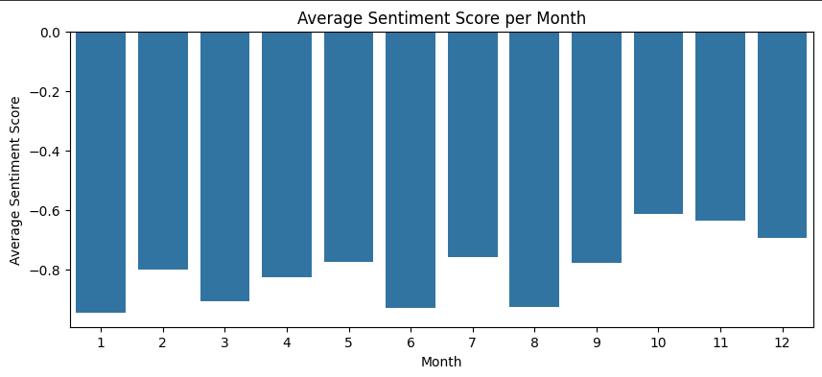
NLP Tweet Sentiment Visualization
Sentiment Score
Closing Price
Visual analysis demonstrated clear patterns in sentiment scores over time.
Correlations were observed between sentiment and closing prices.

Slide 12
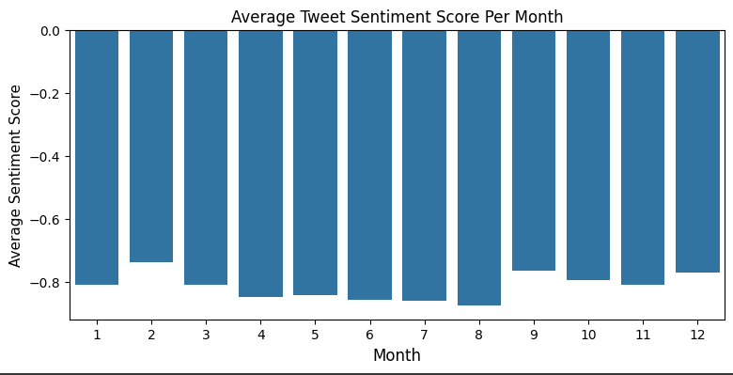
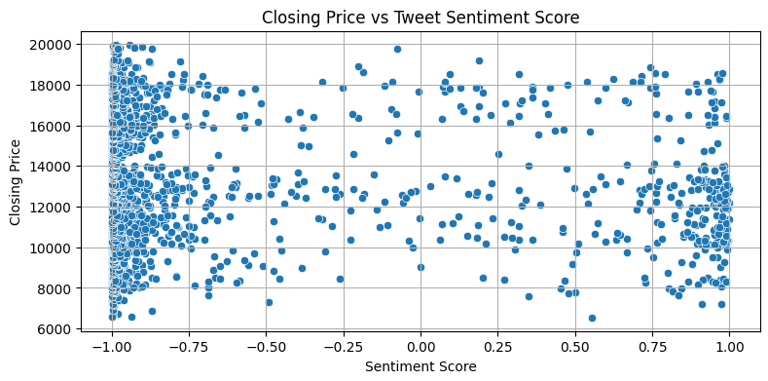
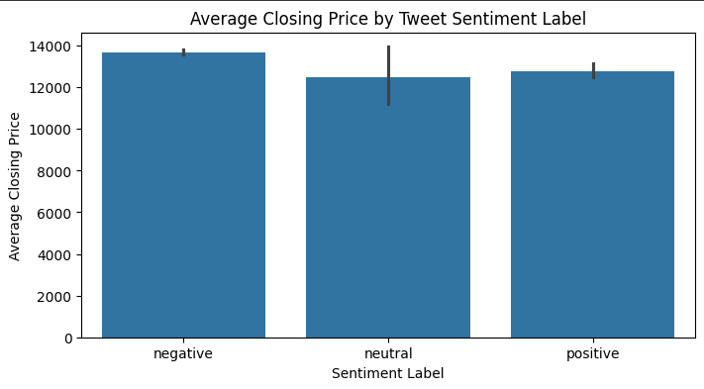
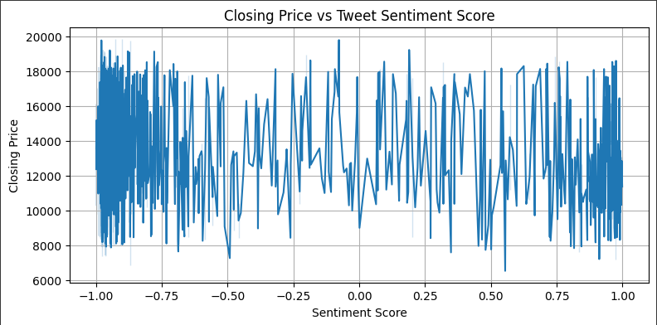
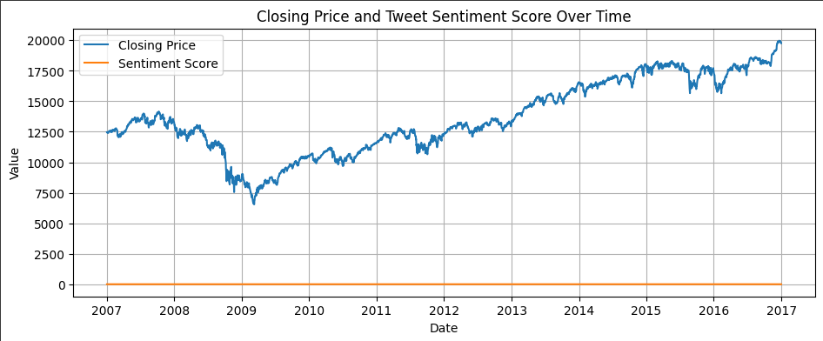
NLP Tweet Sentiment Visualization

Slide 13


Conclusion
Key Points
Public sentiment strongly impacts stock prices.
NLP efficiently analyzes tweet data.
Future Work
Explore advanced NLP techniques.
Implement real-time sentiment monitoring.

